Slide 1


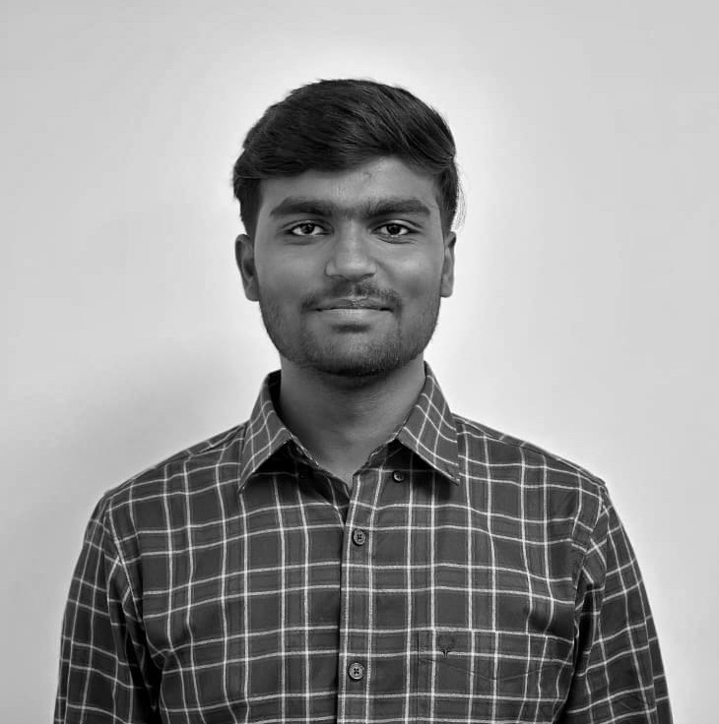




LIKITH B R
Associate Software Engineer
Located in:
Bangalore, India
Meet the Employees of Enterprise Technology
About Me
Hi!
2.5+ years of IT experience, started as a Management Trainee at Intertrust Viteos. Currently working as Associate Software Engineer at CSC.
Aspiring to specialize in DevOps and Expert in Red Hat OpenShift. Certified Azure Administrator Associate (AZ-104)
My Role
implementing Zabbix monitoring on request basis from infra and app teams.
Working on web application project using Python in Docker.
Core technical competency includes PowerShell scripting, hands on experience in Python, Docker.
Providing L1 support for India Fund services and ACE team.
My Interests
Artistic Wood crafting.
3D printing and Prototyping.
FUTURE

